Slide 1


BREAKOUT DISCUSSION
OPERATIONS
PARTNERSHIP
Exploring a Southwestern Health Resources Plan Operations

Slide 2


Claims Processing Excellence
Delivering a positive member and provider experience starts with accurate, efficient, and transparent claims processing
Key Benefit Administrators leverages:
Proven technology
Steamlined workflows
A team dedicated to first pass accuracy
We Consistently:
Exceed industry standard turnaround times and quality metrics
Reduce administrative burdens
Maintain high member and provider satisfaction
Strategic Partnerships:
We partner with Smart Data Solutions for clearinghouse services to empower providers with electronic claims submission and transparency tools.
Currently 82% of our claim volume is received electronically.
Ongoing efforts to increase electronic submissions:
Analyze paper and non-electronic claims
Proactively engage providers for electronic claim setup
We also partner with top tier vendors to provide cost containment solutions to include:
Out of network discounts
High dollar bill reviews
Specialized networks for high-cost conditions such as transplants and dialysis.

Slide 3
Claims Statistics
Claims | Industry Standard | Corporate Goal | Self-Funded Medical Achieved*
Turn Around Time | 10 calendar days | 7 calendar days | 4.25 calendar days
% Paid in 10 days | 80% | 85% | 86.7%
Financial Quality | 99% | 99% | 99.6%
Payment Accuracy | NA | 95% | 97.4%
* Data achieved is for Jan-Jun 2025 calendar year
Groups are provided with a dedicated specialist to handle escalated issues and concerns promptly.
We offer comprehensive, interactive training for claims and customer service staff to prepare them for their roles, using a collaborative LMS system to ensure consistency and accuracy in KBA processes.

Slide 4
KBA Claim Audits
Industry Claim Audits
Post Payment Reviews
Pre Payment Reviews
Claim Processed and Released
Claim is processed and paid
Claim Audited
After the claim has been paid, a post payment audit review is completed
Sent for Corrections
Costly adjustments are handled after the claims have been paid
Claim Processed
Processing completed by claim processor
Claim Audited
Claim not released until determined that it is correct
Sent for Corrections
If incorrect, sent to processor for correction and monitored
Claim Released
Once correct, claim released for payment
We target to audit 1.5%-2.5% of processed claims
Claims are selected with multiple criteria for review
Random
Processor Set Check Amounts
Group Maximums

Slide 5
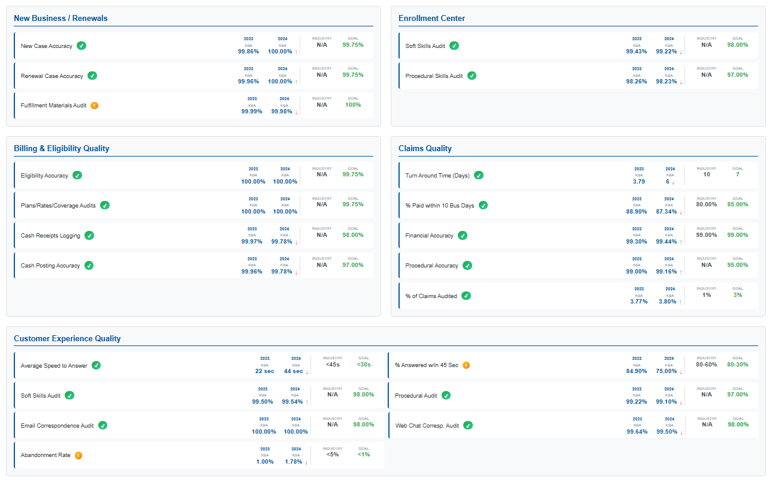



KBA 2023-2024 Total Quality Management Statistics

Slide 6
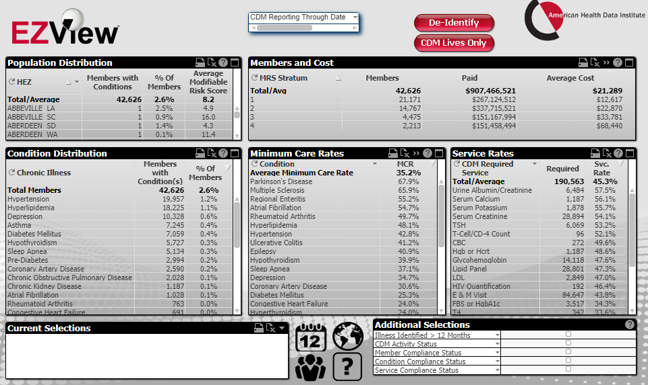
TRANSPARENT ANALYTICS ACCESS
EZView analytics platform provides instant access to critical analytics insights.
Filter to a population by data source, group, plan, or geographic location.
Identifications of chronic conditions, patient acuity, compliance with nurse coaching, regimens of care, steerage rates or claims costs.

Slide 7
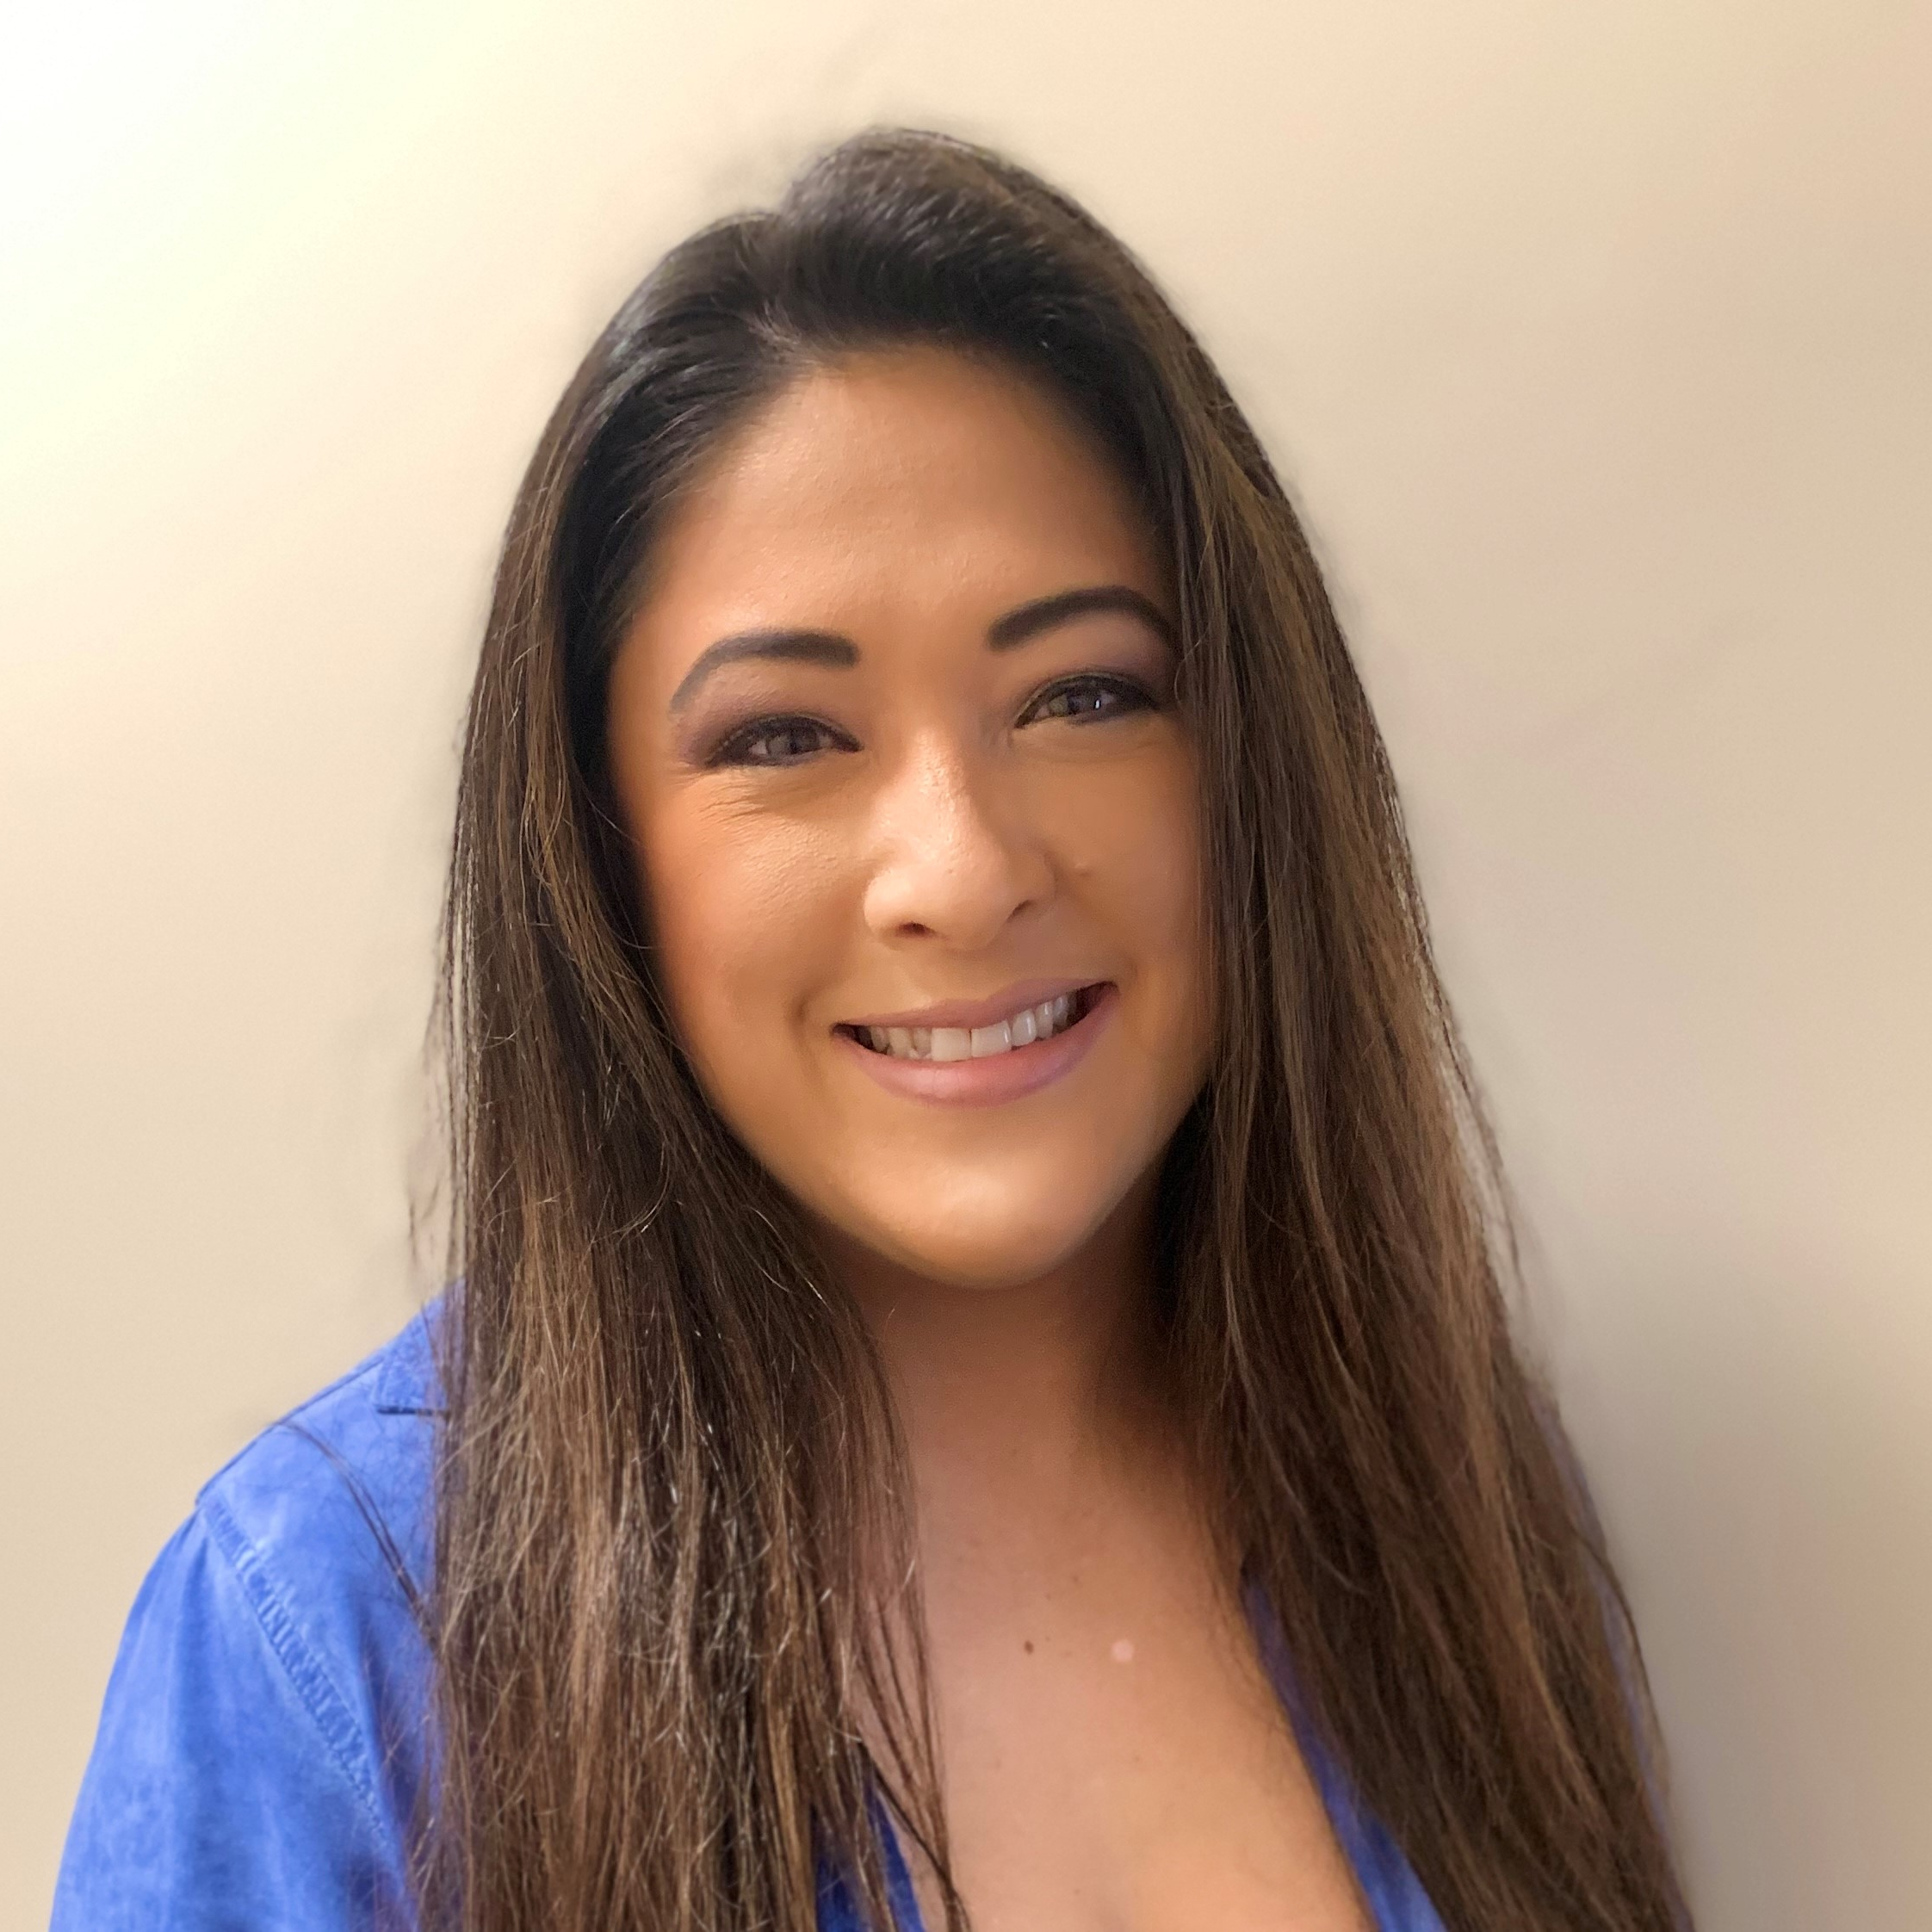
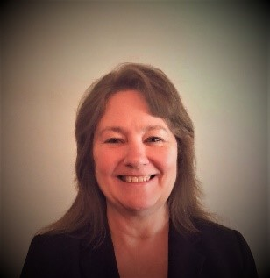
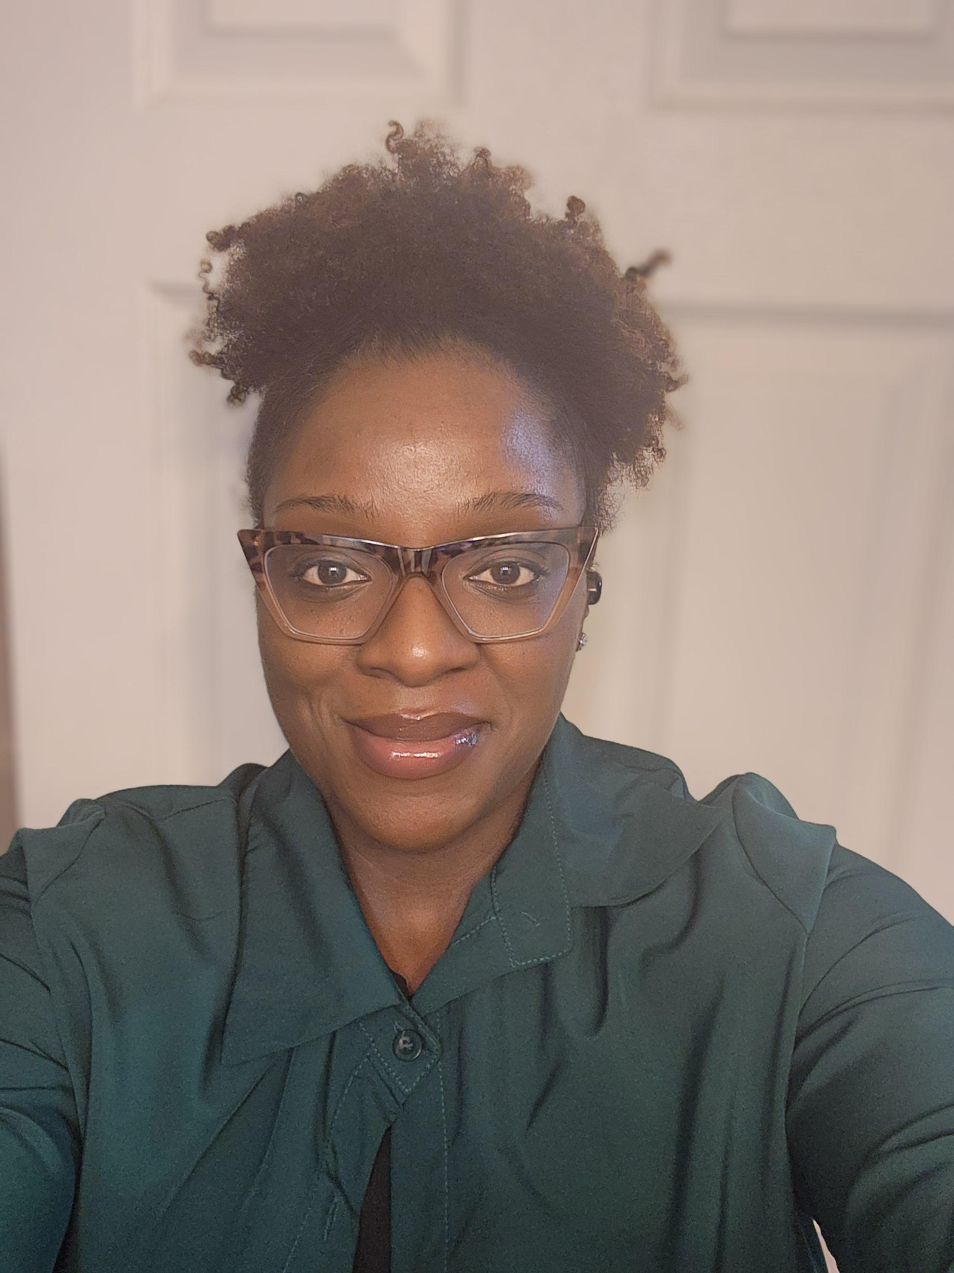
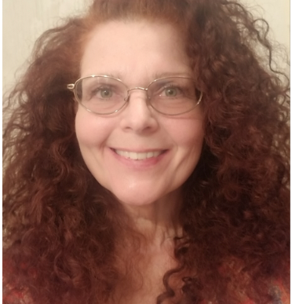
DTE Implementation
Team
Director, Implementation and Network
I joined Key Benefit Administrators in 2000 and have been in the Health Insurance Industry for 20+ years. My focus has been Leadership in Operations, Carrier and Provider Network Relations and Implementation Management.
Office: (803) 323-7974 | Email: Christine.Vinesett@keybenefit.com
Christine Vinesett
Network Operations Lead
Julie Caskey joined Key Benefit Administrators (KBA) in 2021. Julie brings an extensive background with 30+ years in the Health Insurance Industry. Julie’s focus has been in Provider Network and Relationship Management.
Office: 317-712-4003 | Email: Julie.Caskey@keybenefit.com
The DTE Implementation Team is responsible for the overall management of the DTE project plan for the DTE Network and KBA Administrative Operations.
We are always excited about new partnerships and look forward to developing a solid foundation to build upon.
Julie Caskey
DTE Implementation and Relationship Coordinator
Deja joined Key Benefit Administrators in 2023 and has been in the Health Insurance Industry for 10 years. Deja’s focus has been in Provider Network and Relationship Management.
Office: 803-396-4836 | Email: Dejanetta.Pettaway@keybenefit.com
Dejanetta (Deja) Pettaway
DTE Implementation and Relationship Coordinator
Darlene Grindstaff joined Key Benefit Administrators in 2014 and has been in the Health Insurance Industry for 11 years. Darlene’s focus has been in Implementation, Provider Network, and Relationship Management.
Office: 803-396-4784 | Email: Darlene.Grindstaff@keybenefit.com
Darlene Grindstaff

Slide 8
DTE IMPLEMENTATION OVERVIEW
Phase 1 | Phase 2 |  | Phase 3
DTE Network Setup | DTE Marketing & Website Setup | DTE Provider File Setup | Group Sales & Plan Design Setup | Group Administration Setup
☐ Legal Contracts and Agreements | ☐ DTE Name Established | ☐ Provider data and file analysis | ☐ Group Sales and Marketing Strategy | ☐ Proposal system setup
☐ Security and Compliance review | ☐ DTE logo and messaging | ☐ Provider file requirements | ☐ Group Sales collateral | ☐ Group Implementation and Renewal Collateral
☐ Secure email connection - Transport Layer Security (TLS) | ☐ DTE Marketing Collateral | ☐ Provider file transfer | ☐ Group plan design and benefit structure | ☐ Administration system programming (DTE product, plan design, billing, distribution, extract files)
☐ Secure file and reporting connection - Secure File Transfer Protocol (SFTP) | ☐ DTE Website URL (domain) | ☐ Provider file programming and website testing | ☐ PBM plans and benefits review | ☐ Claims adjudication system programming
☐ Network review of providers, specialties and sub-specialties | ☐ DTE Website design and content creation | ☐ Provider maintenance file established | ☐ PBM structure analysis (systems, data import, data export, billing and invoicing) | ☐ Fulfillment programming
☐ Network contracting and pricing analysis | ☐ DTE Website provider portal setup | ☐ DTE Website review for launch | ☐ PBM file structure programming and testing (claims, accumulators, elig, invoice feed) | ☐ Customer Service programming
☐ Network fee schedule programming and testing |  |  | ☐ Reinsurance Carrier education on DTE | ☐ Complete End to End Testing
Network launch | Website launch |  | Group Sales launch

Slide 9
Group Implementation and Client Relations Team
Group Implementation Leadership
Implementation Director
Christine Vinesett
Email: Christine.Vinesett@keybenefit.com | Phone: (803) 323-7974
Implementation Manager
Rachel Morris
Email: Rachel.morris@keybenefit.com | Phone: (803) 396-4775
Implementation Lead
Ashley Gowen
Email: Ashley.gowen@keybenefit.com | Phone: (317) 284-7863
Implementation Coordinator’s will be assigned at kick-off.
Group implementations are assigned members from the Implementation and Client Relations Team. KBA is committed to delivering a “WOW” level of customer service and our team will ensure a smooth and timely transition to KBA.
It is our priority to execute a successful implementation.
Client Relations Leadership
Senior Vice President, Client Relations
Nicole Oliver
Email: Nicole.oliver@keybenefit.com | Phone: (803) 396-4720
Client Relations VP and Account Representative will be assigned at kick-off.

Slide 10
GROUP IMPLEMENTATION OVERVIEW
Phase 1 | Phase 2 | Phase 3 | Phase 4
Implementation Begins | Group Details - Open Enrollment, Eligibility Setup, ID Card, Banking, and Vendors | Finalize Setups - Open Enrollment, Eligibility, ID Card, Banking and Vendors | Confirmations - Fulfillment, Post Implementation Planning, GO LIVE!
☐ Identify key group contacts and their Roles and Responsibilities. | ☐ Confirm Open Enrollment dates. | ☐ Introduce Billing and Customer Service Teams. | ☐ Confirm eligibility loaded.
☐ Review contracts and electronic signature process. | ☐ Discuss materials needed for Open Enrollment and expected delivery. | ☐ Process Open Enrollment eligibility. | ☐ Confirm fulfillment mail date.
☐ Confirm Signor information. | ☐ Discuss COBRA Administration. (if applicable) | ☐ Finalize COBRA Administration setup. (if applicable) | ☐ Confirm COBRA letter and packet mail dates. (if applicable)
☐ Establish meeting schedule, frequency and set target dates. | ☐ Discuss Customer Service setup. | ☐ Finalize EZ Benefits setup. | ☐ Confirm all group setups are complete.
☐ Begin KBA Client Profile. | ☐ Review EDI Setup and initial eligibility file submission. | ☐ Finalize ID Card setup. | ☐ Confirm plan document has been signed.
☐ Request prior plan document. | ☐ Schedule EDI meeting. (if applicable) | ☐ Finalize banking setups. | ☐ Deliver 1st Months Invoice and finalize.
☐ Review plan document, benefits and discuss changes. | ☐ Review EZ Benefits platform. | ☐ Finalize claims and EOB setups. | ☐ Deliver final reinsurance contract.
☐ Request claim file and accumulator data. | ☐ Discuss ID Card setup, approval process and delivery expectations. | ☐ Finalize PBM Implementation. | ☐ Discuss reporting needs for plan year.
☐ Review Fee Schedule, Implementation Fee. | ☐ Discuss Banking and Funding setup for monthly premiums and claims. | ☐ Finalize Plan Document. | ☐ Complete full transition to Client Relationship Team for administration.
☐ Discuss Notice of Termination to prior carrier and obtain copy. | ☐ Discuss frequency of check runs, large dollar claims review, exception process and EOBs. | ☐ Review status of EDI setup. (if applicable)
 | ☐ Discuss monthly premium billing preferences.
 | ☐ Begin PBM Implementation and schedule meetings.
 | ☐ Discuss vendor setup process.
 | ☐ Review special programs. (if applicable)
Live Group Administration

